Slide 1



Have you ever wondered how aircraft travel compares to vehicle travel?

Slide 2
Statistics
Between 2000 and 2014, U.S. vehicle fatalities numbered near 30,000
During this time period, U.S. aircraft fatalities were far below 1,000

Slide 3

Vehicle Statistics

Slide 4

Airline Statistics

Slide 5
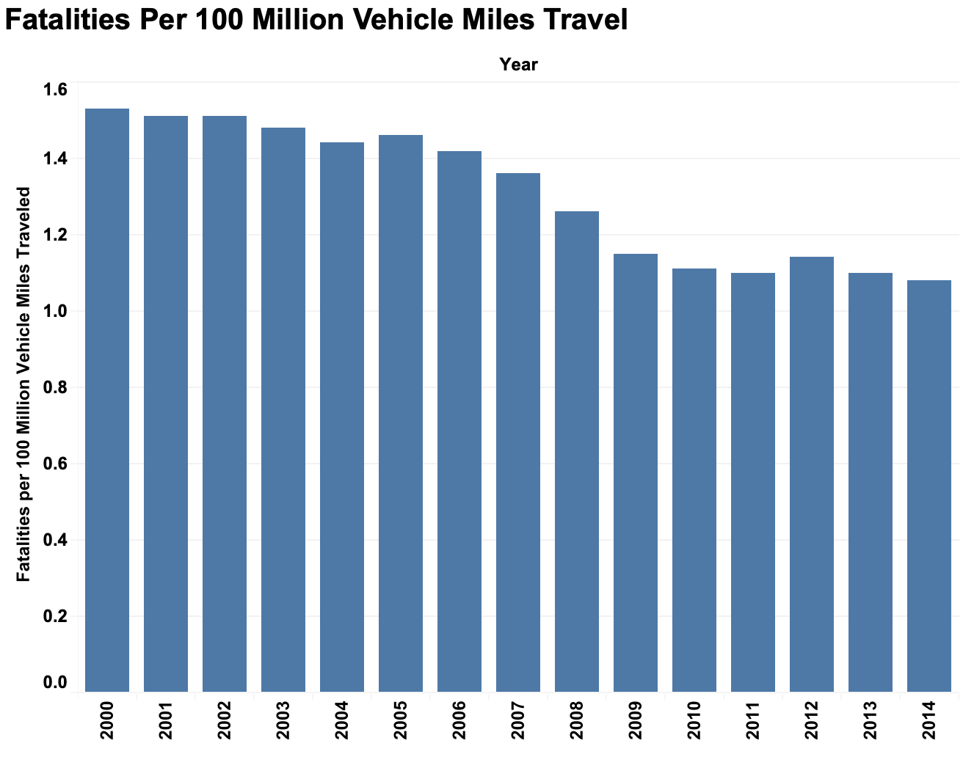
Vehicle Statistics

Slide 6
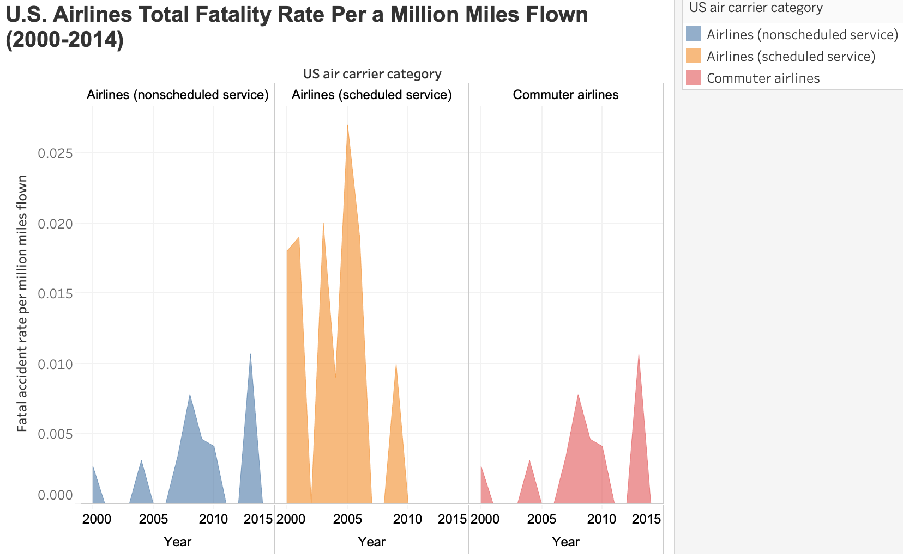
Airline Statistics

Slide 7
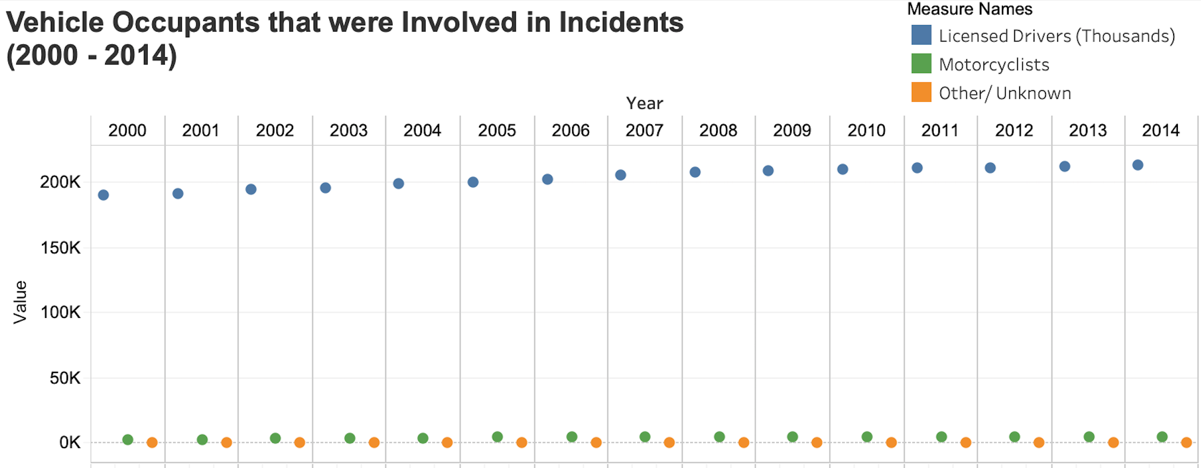
Vehicle Statistics

Slide 8
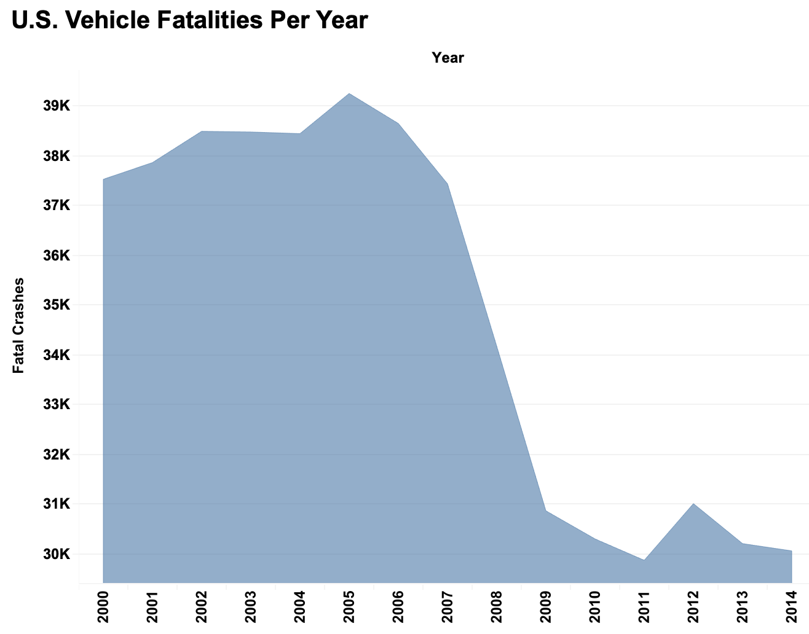
Vehicle Statistics

Slide 9
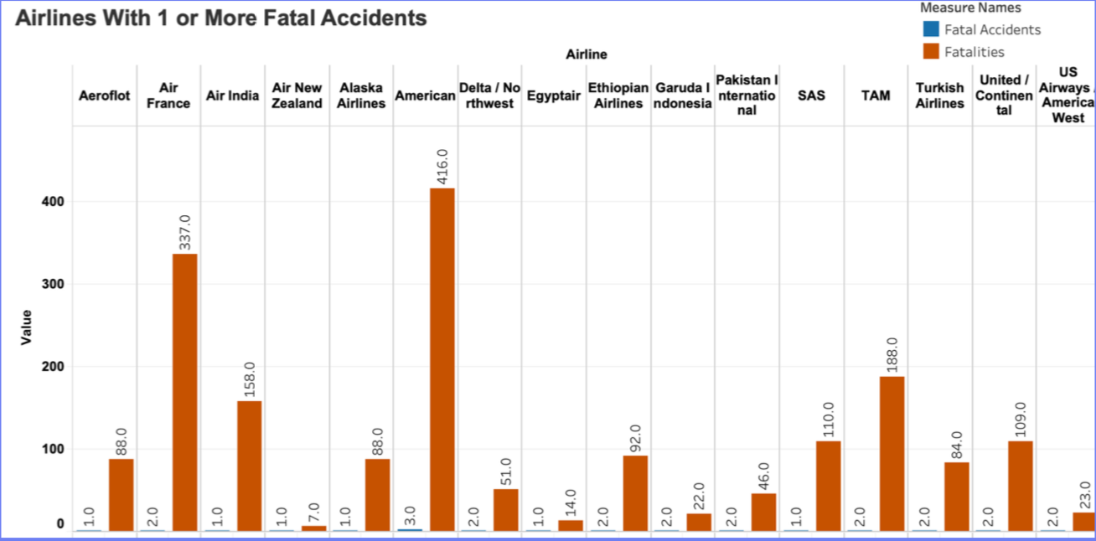
AIRline Statistics

Slide 10
Conclusion
Aircraft travel is a lot more safer than vehicle travel

Slide 11
References
Injury Facts. 2020. Airplane Crashes. Retrieved from https://injuryfacts.nsc.org/home-and-community/safety-topics/airplane-crashes/
Injury Facts. 2020. Deaths by Transportation Mode. Retrieved from https://injuryfacts.nsc.org/home-and-community/safety-topics/deaths-by-transportation-mode/
The Bureau of Aircrafts Accidents Archive. 2020. Accidents Rate Per a Year. Retrieved from http://www.baaa-acro.com/statistics/crashs-rate-per-year?page=1
The Bureau of Aircrafts Accidents Archive. 2020. Death Rate Per a Year. Retrieved from http://www.baaa-acro.com/statistics/death-rate-per-year?page=1
NHTSA. 2020. National Statistics. Retrieved from https://www-fars.nhtsa.dot.gov/Main/index.aspx
GitHub. February 9, 2018. Airline Safety. Retrieved from https://github.com/fivethirtyeight/data/tree/master/airline-safety

